Slide 1
Database Concepts

Slide 2
Topics Covered
Database Design
Relational Model and its Concepts
DBMS Keys
Data Integrity & integrity rules
Data Modelling
Codd’s 12 rules for a Relational Database

Slide 3
Database Design
Process through which the databases need to be designed.
The first part of the design is the logical design where need to identify what are the schemas and what are the constraints that apply, what is authorization required.
Physical design which decides on the physical layout of the data, what are the different database files, how they should be indexed and so on.

Slide 4
Relational Model
Collection of relations
A relation is nothing but a table of values.
Every row in the table represents a collection of related data values.
These rows in the table denote a real-world entity or relationship.
The table name and column names are helpful to interpret the meaning of values in each row.
In the relational model, data are stored as tables
However, the physical storage of the data is independent of the way the data are logically organized.

Slide 5
Relational Model Concepts
Attribute: Each column in a Table. Attributes are the properties which define a relation. e.g., Student Rollno, Name, etc.
Tables – In the Relational model the, relations are saved in the table format. It is stored along with its entities. A table has two properties rows and columns. Rows represent records and columns represent attributes.
Tuple – It is nothing but a single row of a table, which contains a single record.
Relation Schema: A relation schema represents the name of the relation with its attributes.
Degree: The total number of attributes which in the relation is called the degree of the relation.
Cardinality: Total number of rows present in the Table.
Relation instance – Relation instance is a finite set of tuples in the RDBMS system. Relation instances never have duplicate tuples.
Relation key - Every row has one, two or multiple attributes, which is called relation key.
Attribute domain – Every attribute has some pre-defined value and scope which is known as attribute domain

Slide 6
DBMS Keys
A DBMS key is an attribute or set of an attribute which helps you to identify a row(tuple) in a relation(table).
They allow you to find the relation between two tables.
Keys help you to identify any row of data in a table.
In a real-world application, a table could contain thousands of records. Moreover, the records could be duplicated. Keys ensure that you can uniquely identify a table record despite these challenges.
Allows you to establish a relationship and identify the relation between tables
Help you to enforce identity and integrity in the relationship.

Slide 7
DBMS Keys
Super Key
Primary Key
Candidate Key
Alternate Key
Foreign Key
Compound Key
Composite Key
Surrogate Key

Slide 8
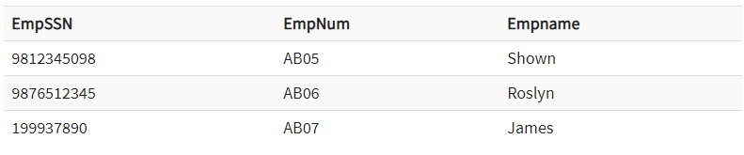
DBMS Keys
Super key
A super key is a group of single or multiple keys which identifies rows in a table.
A Super key may have additional attributes that are not needed for unique identification.

Slide 9
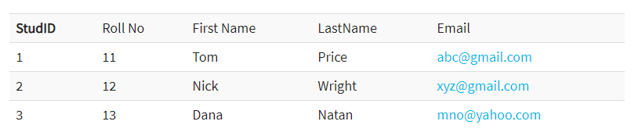
DBMS Keys
Primary Key
Column or group of columns in a table which helps us to uniquely identifies every row in that table is called a primary key. This DBMS can't be a duplicate. The same value can't appear more than once in the table.
Rules for defining Primary key:
Two rows can't have the same primary key value
It must for every row to have a primary key value.
The primary key field cannot be null.
The value in a primary key column can never be modified or updated if any foreign key refers to that primary key.

Slide 10
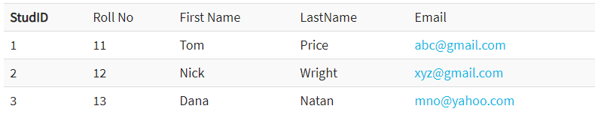
DBMS Keys
Alternate key
All the keys which are not primary key are called an alternate key.
It is a candidate key which is currently not the primary key.
However, A table may have single or multiple choices for the primary key.

Slide 11
DBMS Keys
Candidate Key
A super key with no repeated attribute is called candidate key.
The Primary key should be selected from the candidate keys. Every table must have at least a single candidate key.
Properties of Candidate key:
It must contain unique values
Candidate key may have multiple attributes
Must not contain null values
It should contain minimum fields to ensure uniqueness
Uniquely identify each record in a table

Slide 12
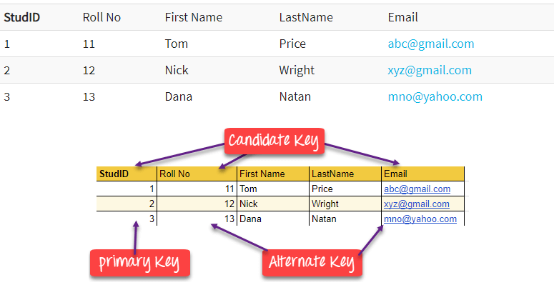
DBMS Keys

Slide 13
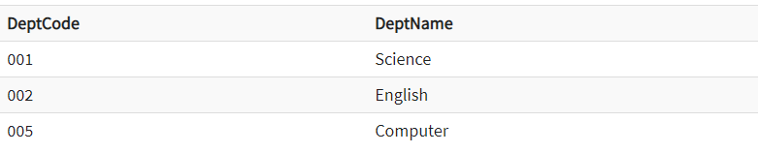
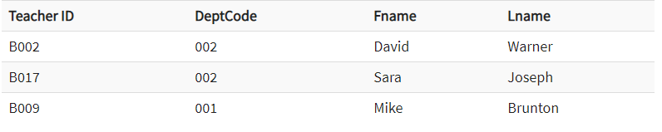
DBMS Keys
Foreign Key
A foreign key is a column which is added to create a relationship with another table.
Foreign keys help us to maintain data integrity and also allows navigation between two different instances of an entity.

Slide 14
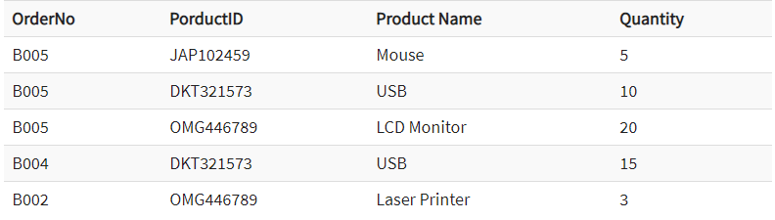
DBMS Keys
Compound Key
Compound key has many fields which allow you to uniquely recognize a specific record.
It is possible that each column may be not unique by itself within the database.
However, when combined with the other column or columns the combination of composite keys become unique.

Slide 15
DBMS Keys
Composite Key
A key which has multiple attributes to uniquely identify rows in a table is called a composite key.
The difference between compound and the composite key is that any part of the compound key can be a foreign key, but the composite key may or maybe not a part of the foreign key.

Slide 16

DBMS Keys
Surrogate Key
An artificial key which aims to uniquely identify each record is called a surrogate key.
These kind of key are unique because they are created when you don't have any natural primary key.
They do not lend any meaning to the data in the table. Surrogate key is usually an integer.
Surrogate keys are allowed when
No property has the parameter of the primary key.
In the table when the primary key is too big or complicated.

Slide 17
Data Integrity & Integrity Rules
Data Integrity is referred to conditions which must be present for a valid relation.
These integrity constraints are derived from the rules in the mini-world that the database represents.
There are many types of integrity constraints.
Constraints on the Relational database management system is mostly divided into three main categories are:
Domain constraints
Key constraints
Referential integrity constraints

Slide 18
Data Integrity & Integrity Rules
Domain Constraints
Domain constraints can be violated if an attribute value is not appearing in the corresponding domain or it is not of the appropriate data type.
Domain constraints specify that within each tuple, and the value of each attribute must be unique.
This is specified as data types which include standard data types integers, real numbers, characters, Booleans, variable length strings, etc.
Create DOMAIN CustomerName CHECK (value not NULL)

Slide 19
Data Integrity & Integrity Rules
Key constraints
An attribute that can uniquely identify a tuple in a relation is called the key of the table. The value of the attribute for different tuples in the relation has to be unique.

Slide 20
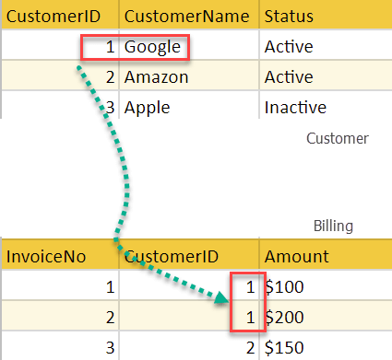
Data Integrity & Integrity Rules
Referential integrity constraints
Referential integrity constraints is base on the concept of Foreign Keys.
A foreign key is an important attribute of a relation which should be referred to in other relationships.
Referential integrity constraint state happens where relation refers to a key attribute of a different or same relation.
However, that key element must exist in the table.

Slide 21
Data Integrity & Integrity Rules
Null rule: A null rule is a rule defined on a single column that allows or disallows inserts or updates of rows containing a null (the absence of a value) in that column.
Unique column values: A unique value rule defined on a column (or set of columns) allows the insert or update of a row only if it contains a unique value in that column (or set of columns).
Primary key values: A primary key value rule defined on a key (a column or set of columns) specifies that each row in the table can be uniquely identified by the values in the key.

Slide 22
Data Modelling
Conceptual: This Data Model defines WHAT the system contains. The purpose is to organize, scope and define business concepts and rules.
Logical: Defines HOW the system should be implemented regardless of the DBMS. The purpose is to developed technical map of rules and data structures.
Physical: This Data Model describes HOW the system will be implemented using a specific DBMS system. The purpose is actual implementation of the database.

Slide 23
Conceptual data model
A conceptual data model identifies the highest-level relationships between the different entities. Features of conceptual data model include:
Includes the important entities and the relationships among them.
No attribute is specified.
No primary key is specified.

Slide 24
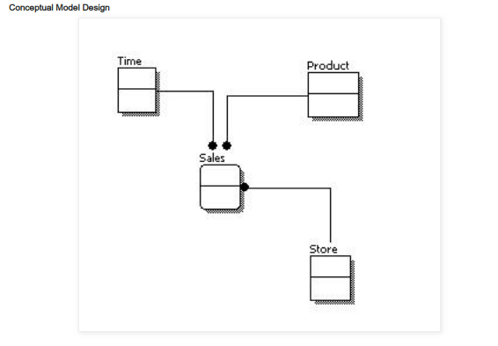
Conceptual Model Design

Slide 25
Logical data model
A logical data model describes the data in as much detail as possible, without regard to how they will be physical implemented in the database. Features of a logical data model include:
Includes all entities and relationships among them.
All attributes for each entity are specified.
The primary key for each entity is specified.
Foreign keys (keys identifying the relationship between different entities) are specified.
Normalization occurs at this level.

Slide 26
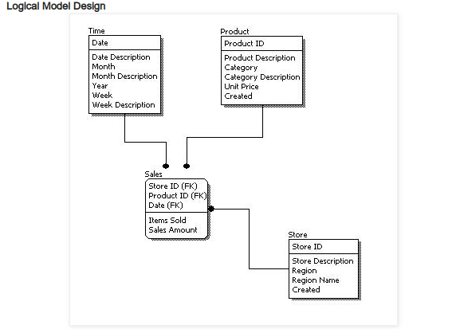
Logical Model Design

Slide 27
Physical data model
Physical data model represents how the model will be built in the database.
Physical data model include:
Specification all tables and columns.
Foreign keys are used to identify relationships between tables.
Physical considerations may cause the physical data model to be quite different from the logical data model.
Physical data model will be different for different RDBMS. For example, data type for a column may be different between Oracle, DB2 etc.

Slide 28
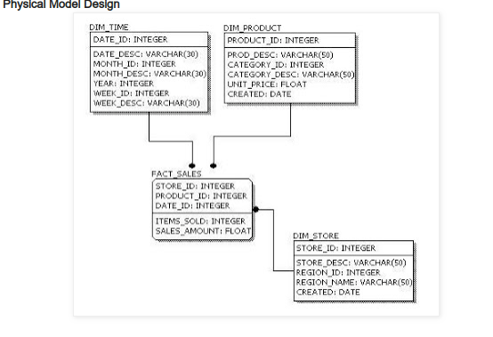
Physical Model Design

Slide 29
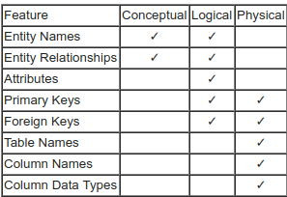
Data modelling

Slide 30
Codd’s 12 rules for a Relational Database
Dr Edgar F. Codd, after his extensive research on the Relational Model of database systems, came up with twelve rules of his own, which according to him, a database must obey in order to be regarded as a true relational database.
These rules can be applied on any database system that manages stored data using only its relational capabilities.
This is a foundation rule, which acts as a base for all the other rules

Slide 31
Codd’s 12 rules for a Relational Database
Rule 1
Information Rule
The data stored in a database, may it be user data or metadata, must be a value of some table cell. Everything in a database must be stored in a table format
Rule 2
Guaranteed Access Rule
Every single data element is guaranteed to be accessible logically with a combination of table-name, primary-key (row value), and No other means, such as pointers, can be used to access data
Rule 3
Systematic Treatment of NULL Values
The NULL values in a database must be given a systematic and uniform treatment. This is a very important rule because a NULL can be interpreted as one the following − data is missing, data is not known, or data is not applicable
Rule 4
Active Online Catalog
The structure description of the entire database must be stored in an online catalog, known as data dictionary, which can be accessed by authorized users. Users can use the same query language to access the catalog which they use to access the database itself

Slide 32
Codd’s 12 rules for a Relational Database
Rule 5
Comprehensive Data Sub-Language Rule
A database can only be accessed using a language having linear syntax that supports data definition, data manipulation, and transaction management operations. This language can be used directly or by means of some application.
Rule 6
View Updating Rule
All the views of a database, which can theoretically be updated, must also be updatable by the system
Rule 7
High-Level Insert, Update, and Delete Rule
A database must support high-level insertion, updation, and deletion. This must not be limited to a single row, that is, it must also support union, intersection and minus operations to yield sets of data records
Rule 8
Physical Data Independence
The data stored in a database must be independent of the applications that access the database. Any change in the physical structure of a database must not have any impact on how the data is being accessed by external applications.

Slide 33
Codd’s 12 rules for a Relational Database
Rule 9
Logical Data Independence
The logical data in a database must be independent of its user’s view. Any change in logical data must not affect the applications using it. For example, if two tables are merged or one is split into two different tables, there should be no impact or change on the user application.
Rule 10
Integrity Independence
A database must be independent of the application that uses it. All its integrity constraints can be independently modified without the need of any change in the application.
Rule 11
Distribution Independence
The end-user must not be able to see that the data is distributed over various locations. Users should always get the impression that the data is located at one site only. This rule has been regarded as the foundation of distributed database systems.
Rule 12
Non-Subversion Rule
If a system has an interface that provides access to low-level records, then the interface must not be able to subvert the system and bypass security and integrity constraints.

